Slide 1

Remote Databases
SoftUni Team
Technical Trainers
Software University
https://softuni.bg

Slide 2
Table of Contents
Relational and Non Relational Databases
Backend as a Service - BaaS
Firebase
Using Firebase BaaS

Slide 3
Have a Question?
sli.do #js-advanced

Slide 4



Relational Databases
Represent and store data in tables and rows
Use Structured Querying Language (SQL)
Allows you to link information from different tables through the use of foreign keys (or indexes)

Slide 5

Non Relational Databases
No-SQL databases
More flexibility and adaptability
Allow us to store unstructured data in a single document
Additional processing effort and more storage as the document sizes grow

Slide 6
Relational and Non Relational Pros
Relational
Work with structured data
They support ACID transactional consistency and support "joins"
Built-in data integrity and a large eco-system
Relationships in this system have constraints
Limitless indexing
Non Relational
They scale out horizontally
Work with unstructured and semi-structured data
Schema-free or Schema-on-read options
High availability
Many are open source and so "free"

Slide 7
Backend As a Service
Solutions that provide pre-built, cloud hosted components for developing application backends
Reduce the time and complexity required
Allow developers to focus on core features instead of low level tasks
Types:
Cloud BaaS
Opensource BaaS

Slide 8
Firebase
Real-Time Cloud DB and App Platform by Google

Slide 9
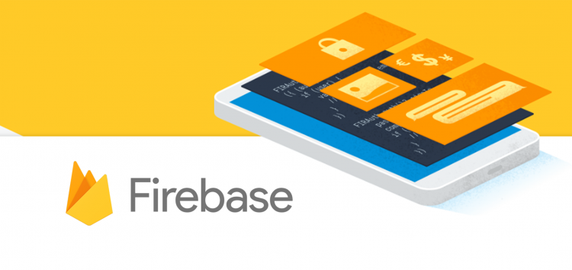
Firebase
Mobile and web development platform. It provides:
Realtime database
Backend as a service
JSON-based data structure

Slide 10
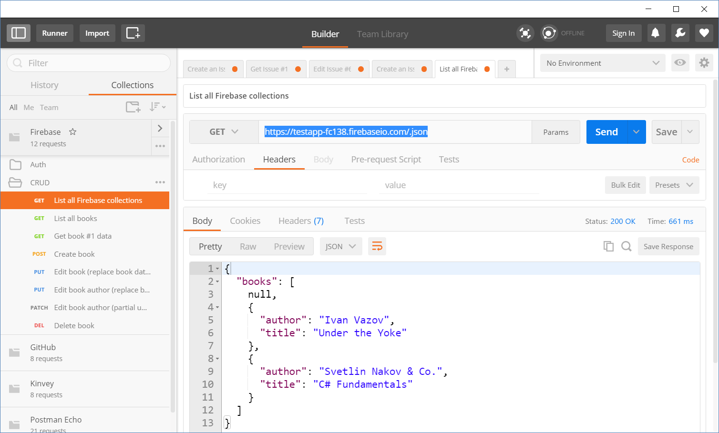
Accessing Firebase REST API with Postman
Append .json to your DB object URL

Slide 11
Firebase REST API – CRUD Operations
GET
https://testapp-fc138.firebaseio.com/.json
GET
https://testapp-fc138.firebaseio.com/books.json
GET
https://testapp-fc138.firebaseio.com/books/1.json
GET
https://testapp-fc138.firebaseio.com/books/1/author.json
POST
https://testapp-fc138.firebaseio.com/books.json
Body
{"title":"New title", "author":"New author"}
DELETE
https://testapp-fc138.firebaseio.com/books/6.json

Slide 12
Firebase REST API – CRUD Operations (2)
PUT
https://testapp-fc138.firebaseio.com/books/7.json
Body
{"title":"Edited", "year":1980, "ISBN":"954X"}
PATCH
https://testapp-fc138.firebaseio.com/books/7.json
Body
{"year":1981, "author":"Author Changed"}
PUT
https://testapp-fc138.firebaseio.com/books/7/author.json
Body
"New author was assigned"
DELETE
https://testapp-fc138.firebaseio.com/books/7/author.json

Slide 13
Authentication vs. Authorization
Authentication
The process of verifying the identity of a user or computer
Questions: "Who are you?", "How you prove it? "
Credentials can be password, smart card, external token, etc.
Authorization
The process of determining what a user is permitted to do on a computer or network
Questions: " What are you allowed to do?", "Can you see this page?"

Slide 14
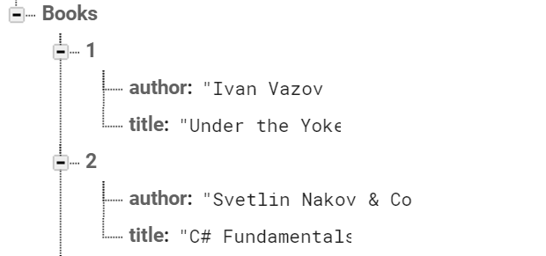

Firebase and Postman: All Books
Open Firebase and create "TestApp" project
Create the following structure
Get all books by AJAX request

Slide 15
Firebase and Postman: Get Book
Using the recently created project in Firebase
Get the book with id: 1
Don't forget the .json extension at the end

Slide 16
Firebase and Postman: Create Book
To create a book in our Firebase project
Send a "POST" request
JSON body should be in the following format:
{
"title":"New title",
"author":"New author"
}

Slide 17

Backendless
Cloud backend platform

Slide 18
Backendless As Back-End
Application backend and API services platform
Holds your app / mobile app data in the cloud
Hold users and user data
Users (API for creating an account)
Data collections/tables (API for CRUD operations)
Files (upload / download / delete)

Slide 19
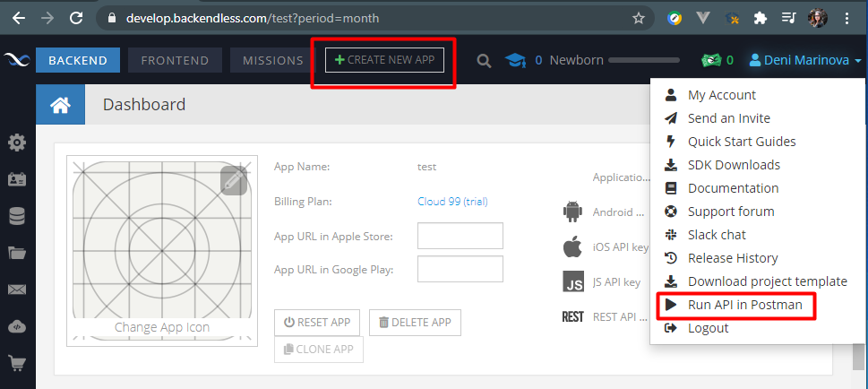
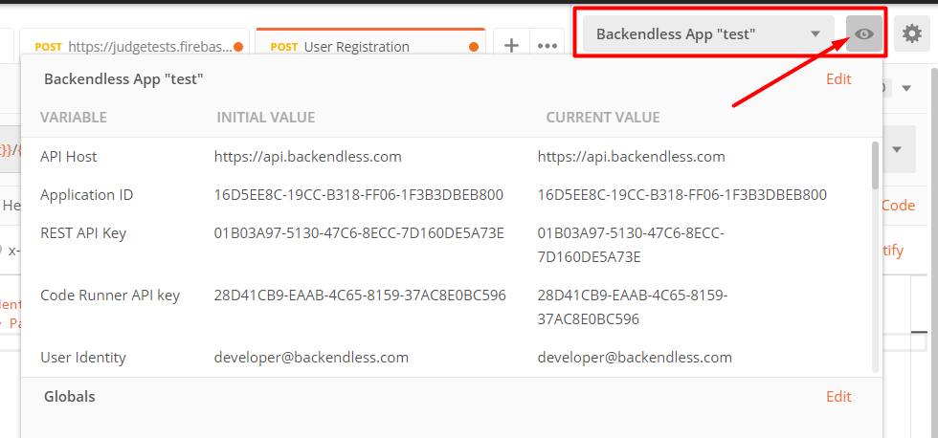
Backendless & Postman
Create a new app
Run API in Postman
Postman will automatically load your full API info:
https://backendless.com/run-backendless-rest-apis-in-postman/

Slide 20
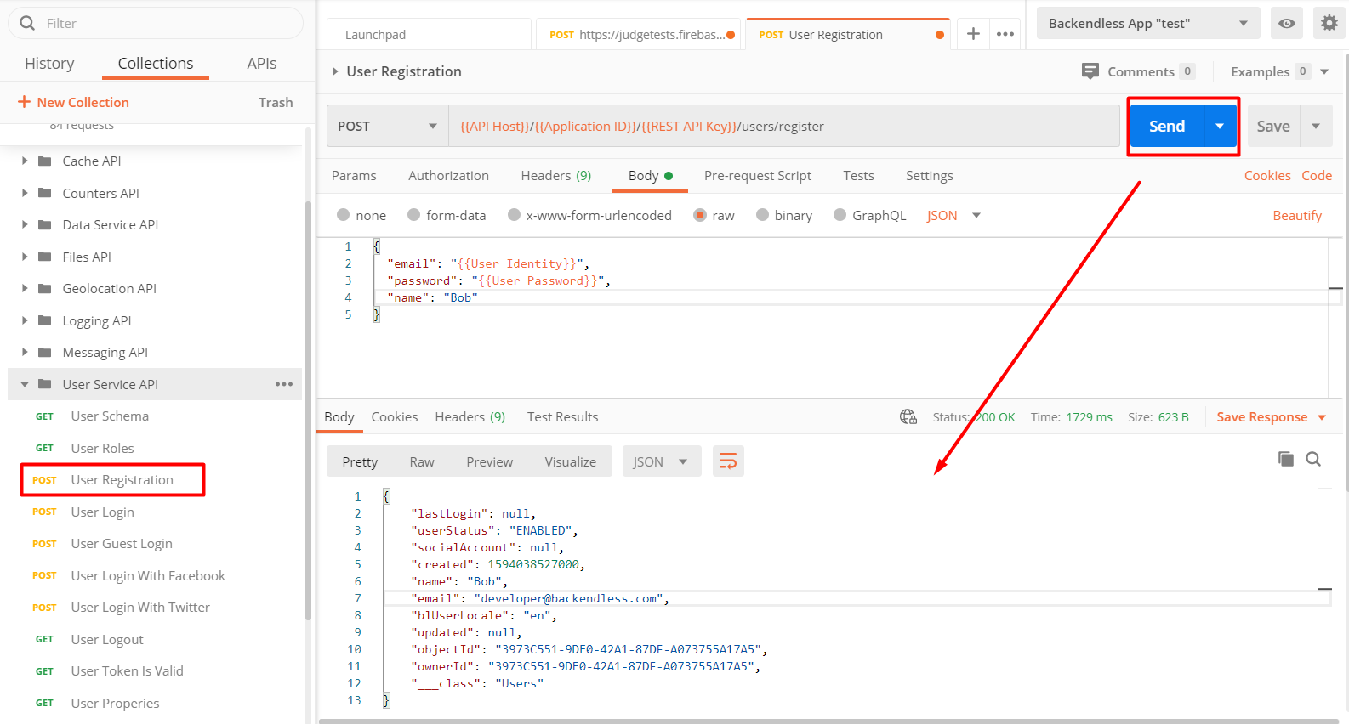
Backendless and Postman: Register
https://api.backendless.com/application-id/REST-api-key/users/register
URL: https://api.backendless.com/application-id/REST-api-key/users/register
URL and Body are automatically filled
Method: POST
Returns: object with full user information
Choose the service and Postman will do the rest

Slide 21
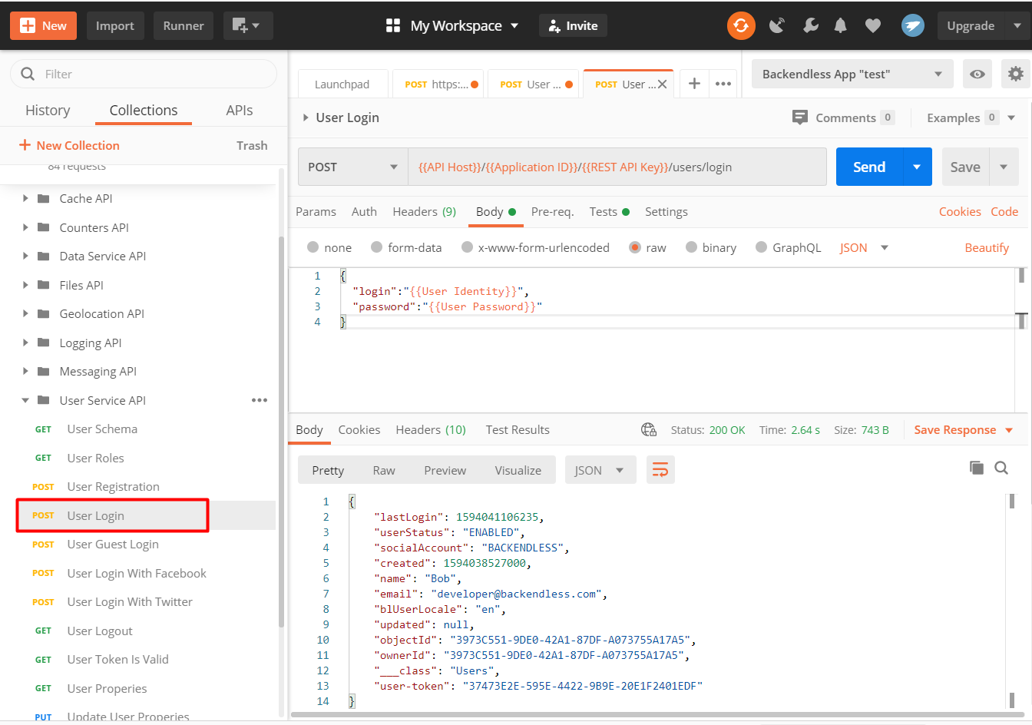
Backendless and Postman: Login
URL: https://api.backendless.com/application-id/REST-api-key/users/login
Method: POST
Returns: authtoken
"user-token": "37473E2E-595E-4422-9B9E-20E1F2401EDF"

Slide 22
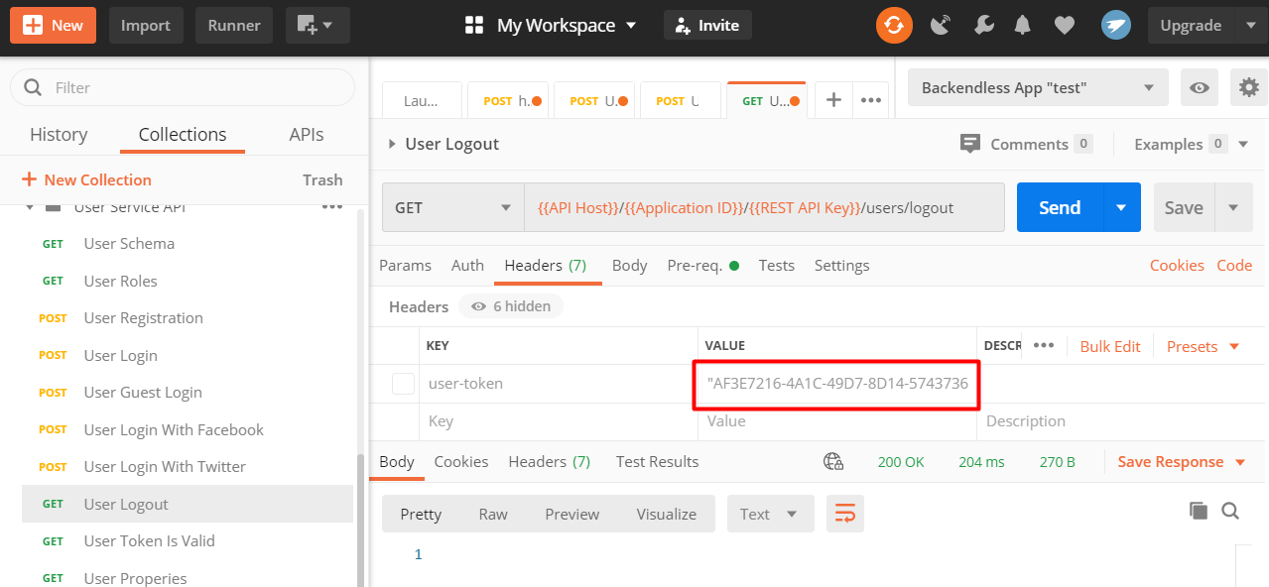
Backendless and Postman: Logout
URL: https://api.backendless.com/application-id/REST-api-key/users/logout
Method: GET
Use the token given by the login request
Returns 200 OK

Slide 23
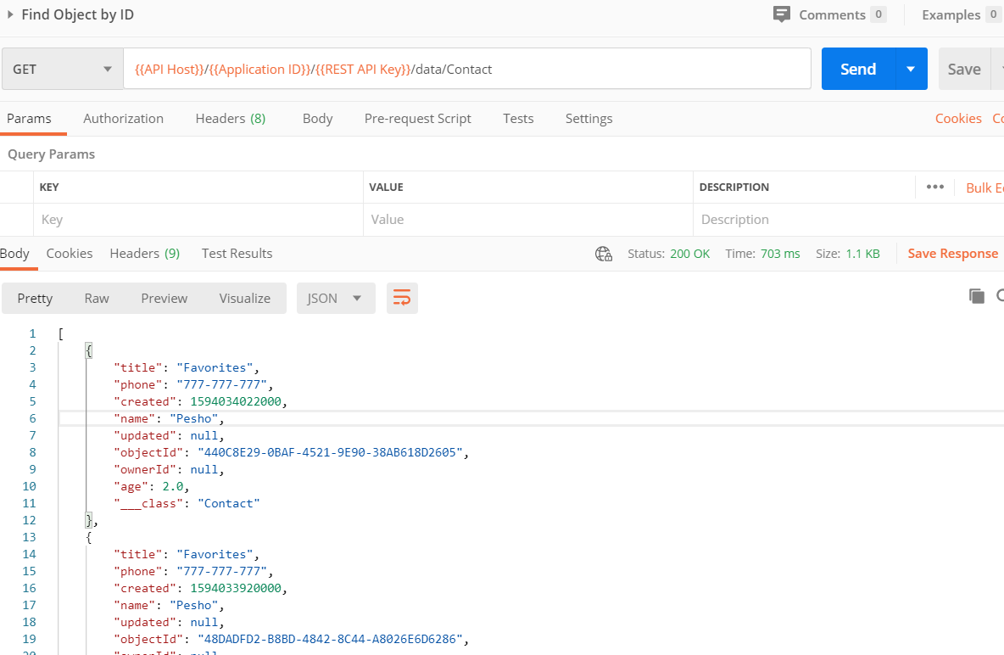
Backendless and Postman: List All Posts
URL: https://api.backendless.com/{{Application ID}}/{{REST API Key}}/data/{{Table Name}}
Method: GET
Returns 200 OK

Slide 24
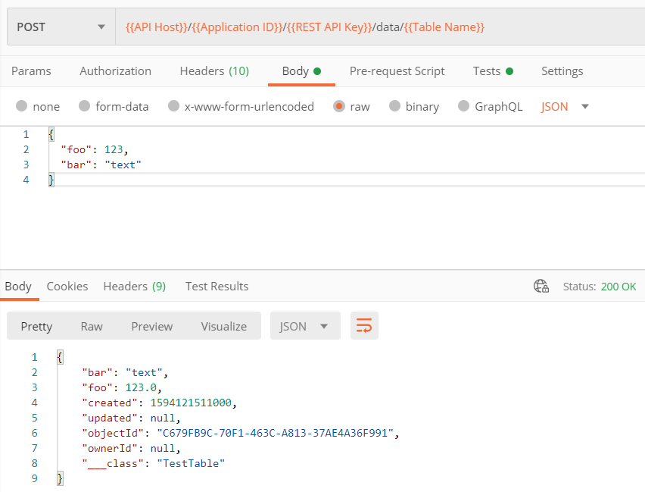
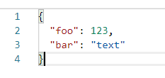
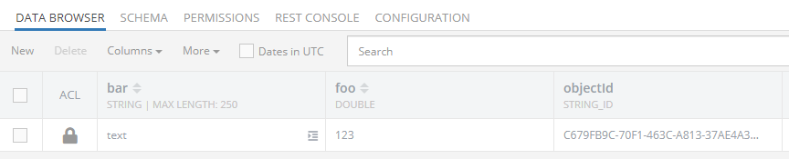
Backendless and Postman: Create Data Object
URL: https://api.backendless.com /{{Application ID}}/{{REST API Key}}/data/{{Table Name}}
Method: POST
Request body:

Slide 25
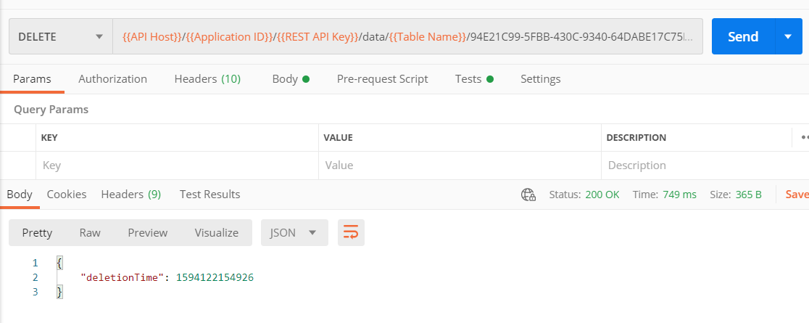
Backendless and Postman: Delete Data Object
URL: https://api.backendless.com/{{Application ID}}/{{REST API Key}}/data/{{Table Name}}/{{Object ID}}
Choose an existing post's ID
Method: DELETE
Returns object with deletionTime

Slide 26
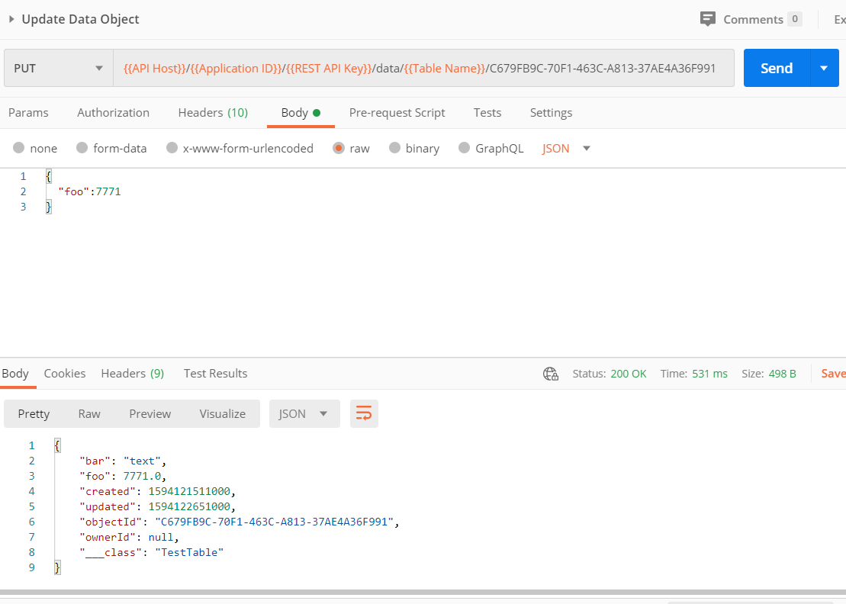


Backendless and Postman: Edit an Existing Post
URL: https://api.backendless.com/{{Application ID}}/{{REST API Key}}/data/{{Table Name}}/{{Data Object ID}}
Choose an existing post's ID
Method: PUT
Body (JSON): { “foo”:7771 }

Slide 27

Live Exercises

Slide 28
Summary
…
…
…
Relational Databases
Non Relational Databases
BaaS
Firebase is JSON-based cloud database
(mBaaS) with REST API
Backendless is collection-based could database (mBaaS) with REST API

Slide 29
Questions?
Notes:
29

Slide 30
Trainings @ Software University (SoftUni)
Software University – High-Quality Education, Profession and Job for Software Developers
softuni.bg, about.softuni.bg
Software University Foundation
softuni.foundation
Software University @ Facebook
facebook.com/SoftwareUniversity
Software University Forums
forum.softuni.bg
Notes:
30

Slide 31

License
This course (slides, examples, demos, exercises, homework, documents, videos and other assets) is copyrighted content
Unauthorized copy, reproduction or use is illegal
© SoftUni – https://about.softuni.bg/
© Software University – https://softuni.bg
Notes:
31

